Slide 1

Children’s voices – Covid-19
South Africa and Indonesia 2022

Slide 2
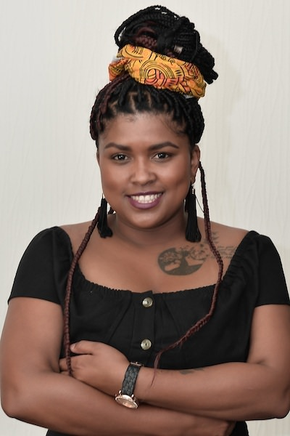
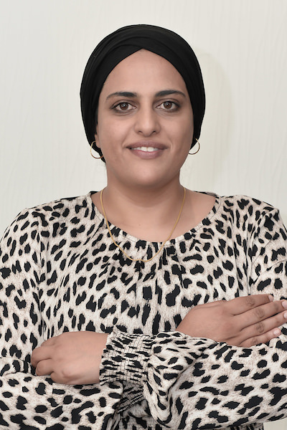
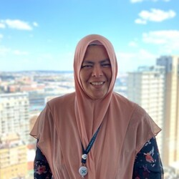
ATLANTIC FELLOWS
Chaleen Arendse (South Africa), Haseena Majid (South Africa); Rennta Chrisdiana (Indonesia)

Slide 3
Introduction
Two country collaboration arising from brainstorming sessions offered by the Atlantic Institute during 2021 – vaccine equity
AIM – We wanted to understand how children felt about the COVID-19 pandemic
OBJECTIVE –
To compare the lived experiences and feelings of children from 2 LMIC’s during the lockdown of 2021
To create agency amongst children to identify and verbalise their experiences
To support children to participate in forums and to make contributions toward platforms that represent their interests.

Slide 4
Collaboration – south Africa and Indonesia
South Africa
Engaged multiple stakeholders for participation at local and national levels – child forums/organisations with child specific programs. Timing was a challenge, commitment and interest was low due to activity timing (September-November 2022)
Participants were sourced from the Western Cape – 50 children between 10-18yrs old
2 fellows – Chaleen Arendse, Haseena Majid – USAWA for Learning and Healing
Indonesia - Rumpun Nurani – Rennta Chrisdiana
Worked with 41 children with varying abilities – included literate, illiterate, hearing impaired.

Slide 5
Activities
Register a formal study – ethical clearance – this posed a challenge – timing across countries for the clearance differed, the waiting period and academic requirements would become a barrier to achieving time-based goals
Stakeholder engagements – Zoom and physical engagements in South Africa and Indonesia with local government, existing forums, children sector leaders, civil society organisations.
Develop a focus group tool that could be used for both countries – translation
Training facilitators
Focus group discussions, peace clubs, skills clinics, interviews with children
Data Collection and Analysis

Slide 6
Findings
The common feelings expressed by the children across both countries are:
Loneliness, fear, sadness
The common challenges faced:
Impact to household income, loss of life (immediate relatives and community members), hunger, low access to school and education opportunities
Main themes emerging from interviews and focus group discussions:
Mental health, education, socio-economic challenges

Slide 7
Vaccine access and vaccine equity
For children with exposure to forums – they were making contributions to strategic activities around COVID-19, for the rest information was obtained from common media points, family and communities.
Children felt that they were viewed as incompetent and thus excluded from engagements about them in matters relating to COVID 19 policy and regulations.
Some children in Indonesia were aware about community level structures for children – health forums
Child forums in South Africa are exclusionary – urban, economic bias, not easily accessible. Civil society organisations focusing on children have closed the gap in some areas.

Slide 8
Outcomes
Webinars – stakeholders and children
Skills workshops – encourage expressive written and oral communication, debate and discussion around covid – 19 and equity
Peer Coaching
Peace clubs – helping children unpack and process experiences in a culture, tradition, spiritual context
Book – messages from the youth about their experiences
Academic paper and a policy brief
Indonesia – South Africa collaboration

Slide 9
Impact
A fundamental change observed in both groups was the interest in preparedness to respond to global and national crisis. Children have become more conscientized about their role in relation to their communities and environments.
Regarding health care and health access – Children expressed an awareness and concern about the state of health care in their countries and the burden caused by COVID -19. Preventive behaviour in the greater context of health was a common interest.
Peer coaching has created a support structure within the groups that do not have access to forums – the skills sharing workshops and peace clubs established will be supported until schools re-open in Mid January 2023. Violence, sexual assault, hunger and loss of life in the absence of access to trauma support has left children feeling vulnerable.
Collaboration with child focused organisations and through additional grant funding will allow for further engagement in 2023 in South Africa.

Slide 10
Budget
Thank you to the Atlantic Institute – United Kingdom for the financial support.
Limitations –
Travel to Indonesia for 2 SA fellows did not materialize – the budget was repurposed for:
Facilitators, facilitator training, peace clubs, skills workshops, focus group discussions and interviews.

Slide 11
Next steps
Share information on social media platforms, with ministries of education and other relevant government stakeholders.
Strengthen civil society networks to find sustainable solutions for peer coaching and group engagements.
Feedback and close off sessions with children and facilitators.
Reporting

Slide 12


